Slide 1

Visualizing
Software Security
Richard Johnson
richardj@microsoft.com

Slide 2
Opening Questions
How can we use the visualization tools we currently have more effectively?
How can the Software Development Lifecycle benefit from visualizations?
What is the impact of visualizations on our software security processes?

Slide 3
Visualization 101
What is visualization?
  Information transmission through imagery
Why is visualization important?
  Visualizations utilize the mind’s most perceptive input mechanism
What are the challenges in visualization?
  Create intuitive spatial mappings of non-spatial data
  Retain clarity while presenting highly dimensional data

Slide 4
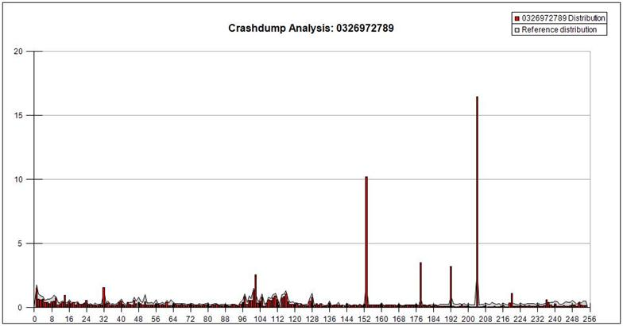
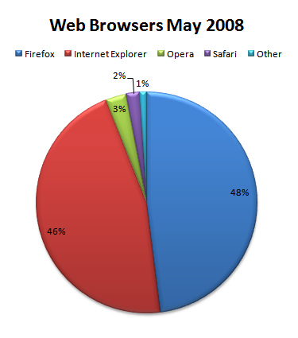
Visualization Taxonomy
Data Visualization

Slide 5
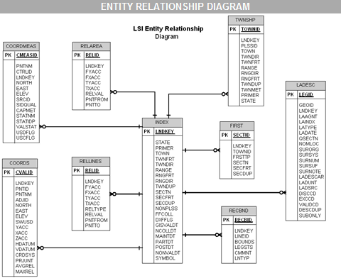
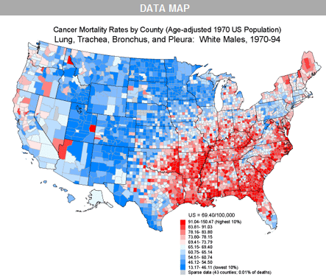
Visualization Taxonomy
Information Visualization

Slide 6
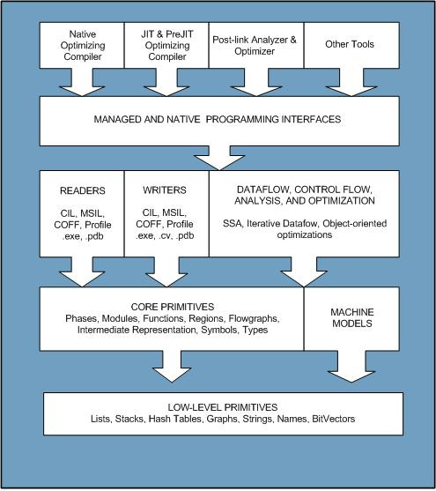
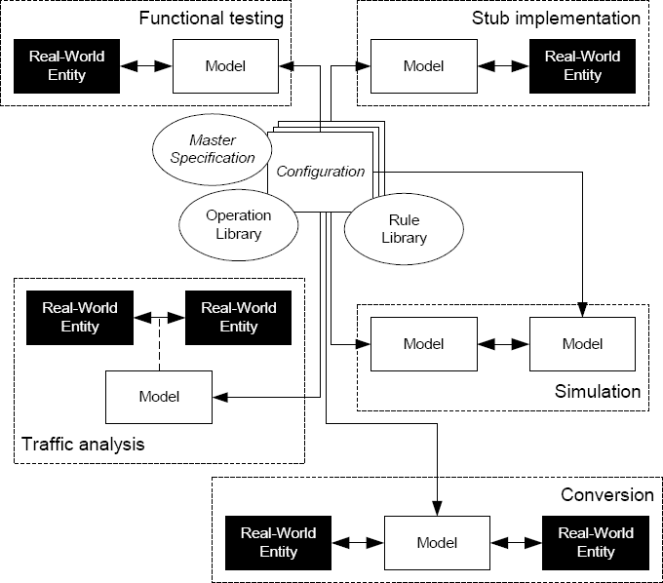
Visualization Taxonomy
Concept Visualization

Slide 7
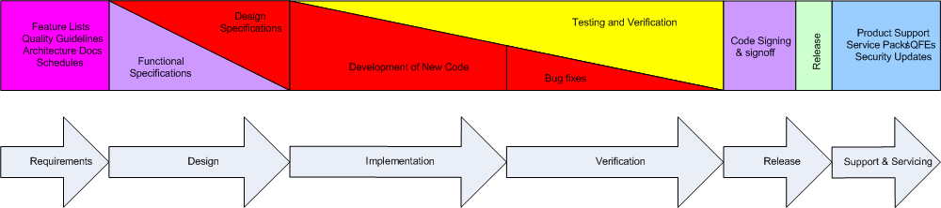
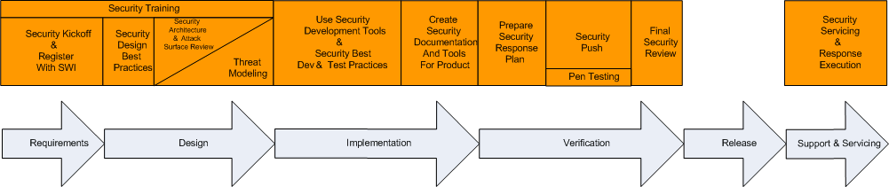
Visualization Taxonomy
Strategy Visualization

Slide 8
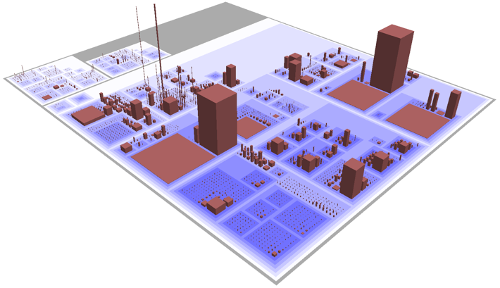
Visualization Taxonomy
Metaphor Visualization

Slide 9
Software Visualization
Problem Space
  Program Visualization
  Algorithm Visualization
Sourcing Data
  Static vs Dynamic data
  Inaccurate analysis tools
The goal is always: Reduce Complexity!

Slide 10
Static Software Properties
Structural Connectivity
  Execution & Data Flow
  Class Hierarchies
State Machine Models
  Memory profile
  Algorithm Complexity
Revision History
  Age and authorship
  Milestones in quality assurance

Slide 11
Dynamic Software Properties
Execution tracing
  Code coverage
  Indirect relationships
  Dynamic dependencies
Memory tracing
  Heap management patterns
  Object instances
  Taint propagation
Environment

Slide 12
Software Security Properties
Attack Surface Area
  Dataflow entry points
  Privilege boundaries
Implementation Flaws
  Arithmetic flaws
  Comparison flaws
  Unchecked user input
Exploitability
  Execution environment
  Compiler security
  Reachability
History
  Code age
  Author credibility

Slide 13
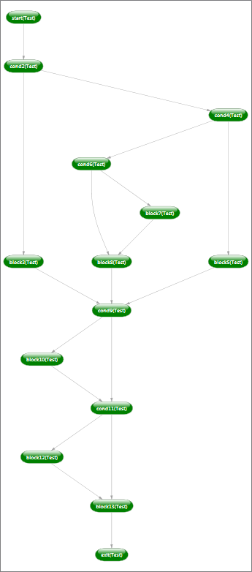
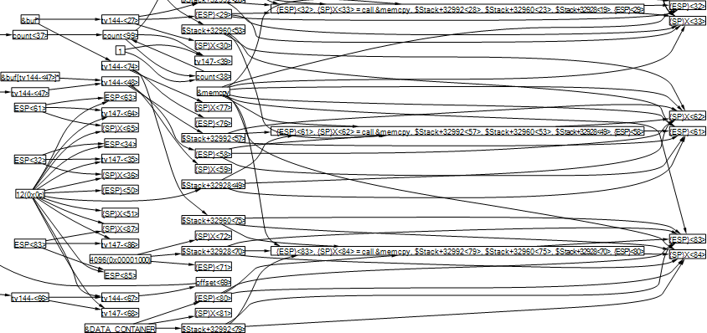
Graph Visualization
Hierarchical Layout
  Layered by order of connectedness
  Not for highly connected graphs

Slide 14
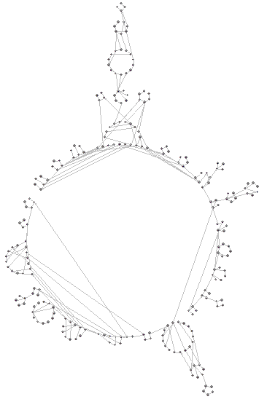
Graph Visualization
Circular
  Nodes aligned on circles
  Clustering

Slide 15
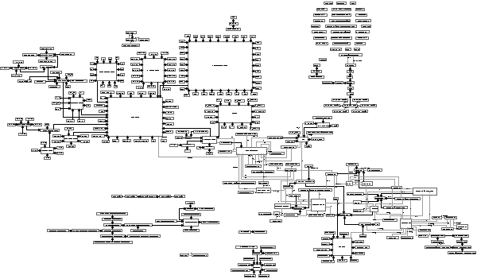
Graph Visualization
Orthogonal
  Edges aligned on axes
  Clustering

Slide 16
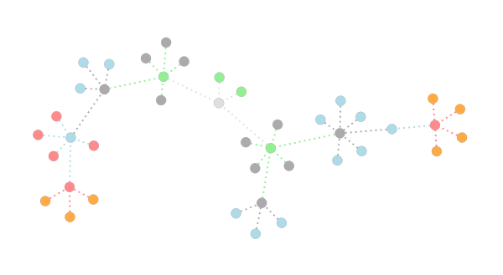
Graph Visualization
Force Directed
  Spring, Magnetic, and Gravitational force
  Packing

Slide 17
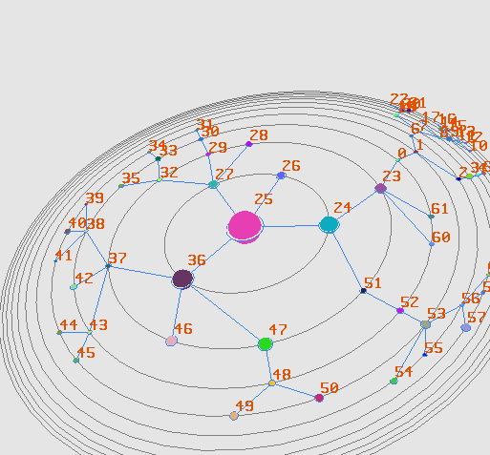
Improved Graph Visualization
Hyperbolic Space
  Clarity on center focus
  Packing

Slide 18
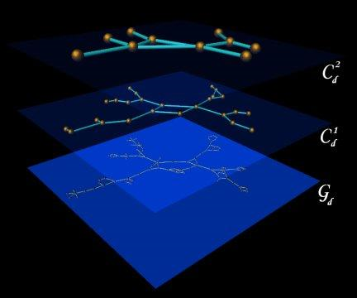
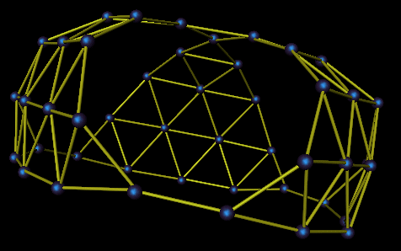
Improved Graph Visualization
Higher Dimensional Space
  Clarity with high connectivity
  Multi-level views

Slide 19
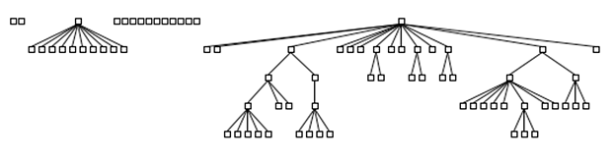
Visual Attributes
Nodes
  Spatial coordinates
  Spatial extents
  Color
  Shape
Edges
  Color
  Shape
  Width
  Style

Slide 20
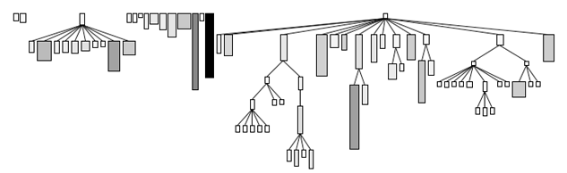
Visual Attributes
Nodes
  Spatial coordinates
  Spatial extents
  Color
  Shape
Edges
  Color
  Shape
  Width
  Style

Slide 21
Visual Attributes
Nodes
  Spatial coordinates
  Spatial extents
  Color
  Shape
Edges
  Color
  Shape
  Width
  Style

Slide 22
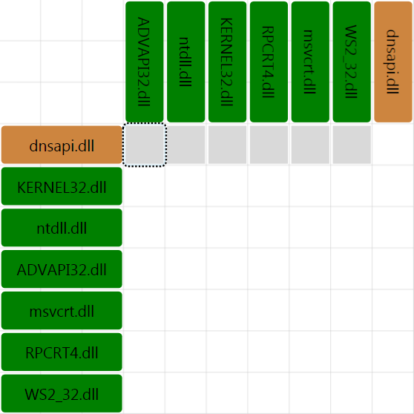
Visualizing Software Security
Observe binary interdependencies

Slide 23
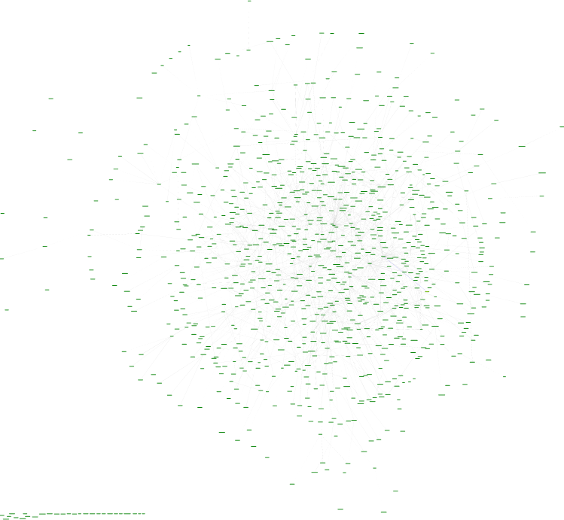
Visualizing Software Security
Acquire a method level control flow graph

Slide 24
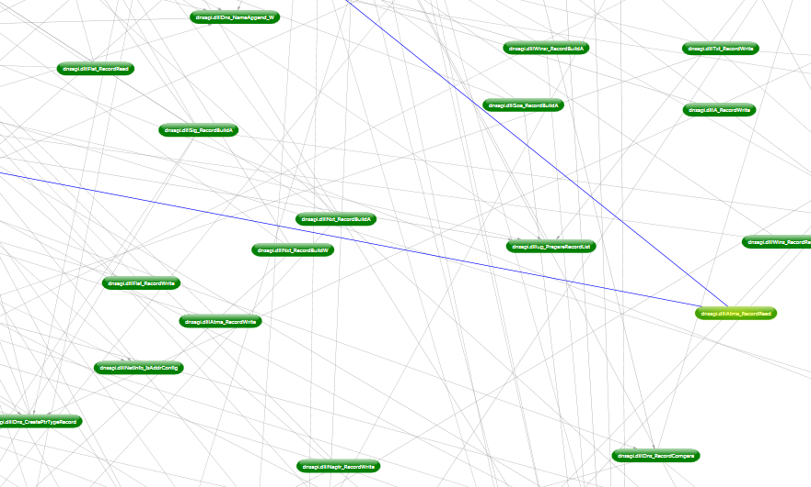
Visualizing Software Security
Acquire a method level control flow graph

Slide 25
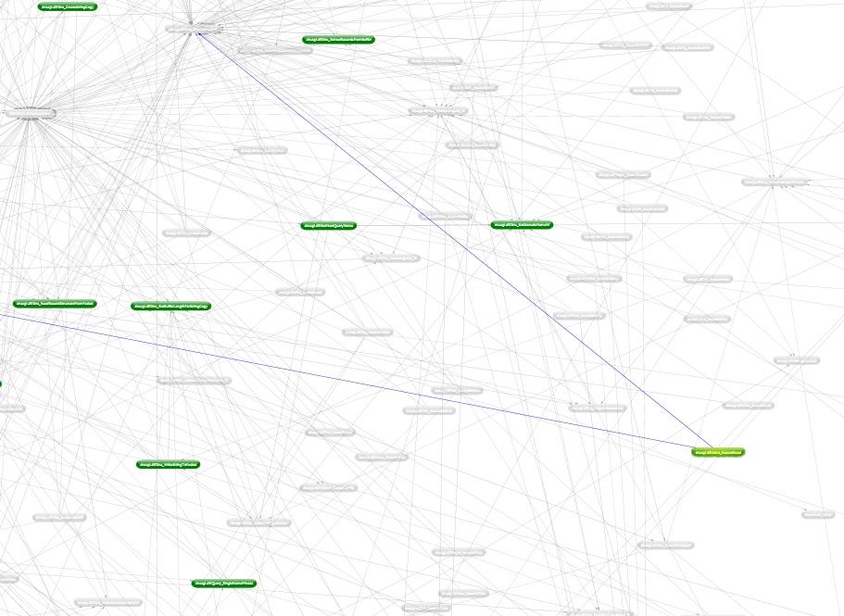
Visualizing Software Security
Reduce graph using code coverage data

Slide 26
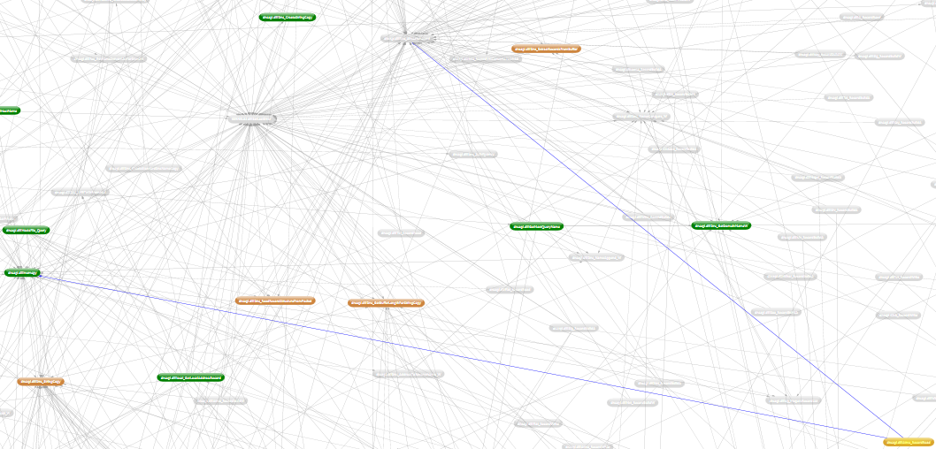
Visualizing Software Security
Trace dataflow dependency to discover taint propagation

Slide 27
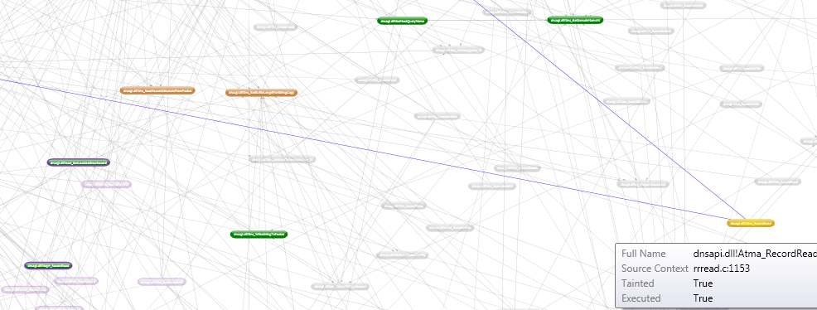
Visualizing Software Security
Use static analysis plugins to derive security properties such as GS and SafeSEH

Slide 28
Visualizing Software Security
Use static analysis plugins to derive security properties such as GS and SafeSEH

Slide 29
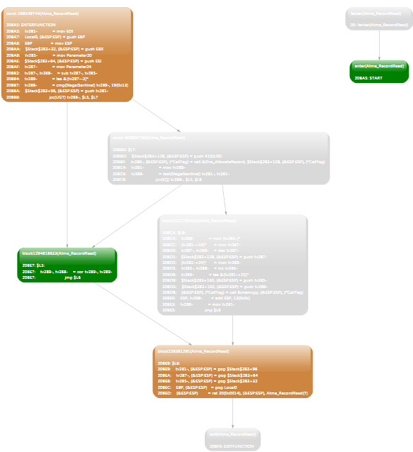
Visualizing Software Security
Analyze non-covered paths in tainted functions

Slide 30
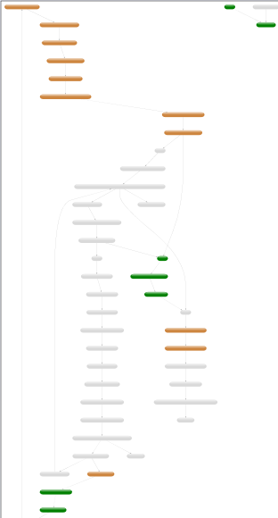
Visualizing Software Security
Analyze non-covered paths in tainted functions

Slide 31
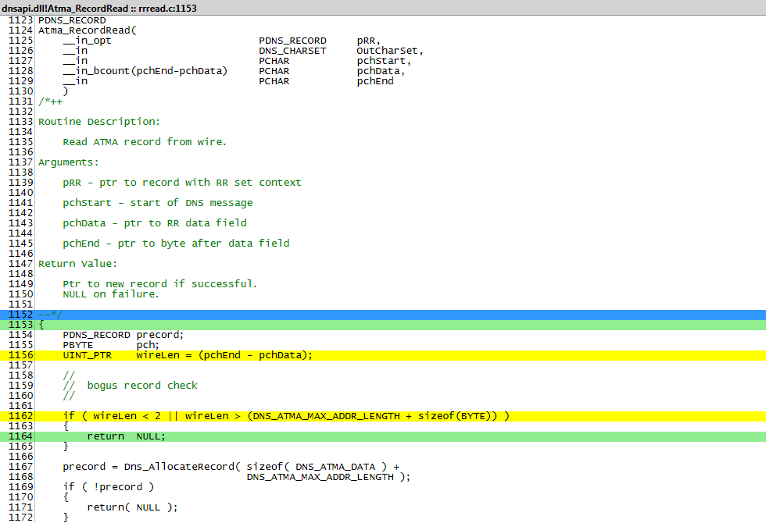
Visualizing Software Properties
Examine source code where correlations
occur

Slide 32
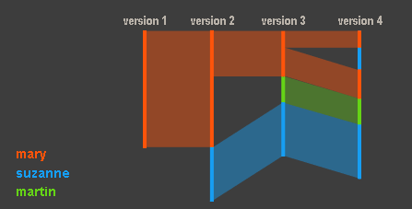
Beyond Graphs
Source Code Revision History
  History Flow

Slide 33
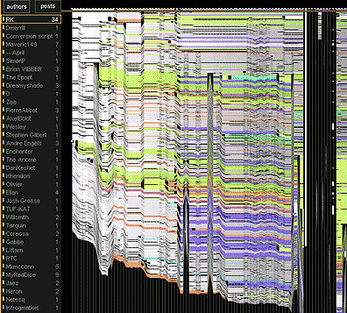
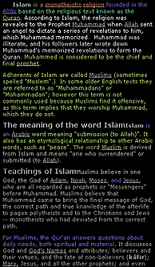
Beyond Graphs
Source Code Revision History
  History Flow

Slide 34
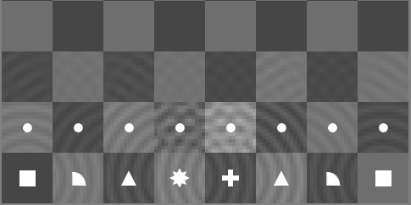
Beyond Graphs
State Machine Models
  Thinking Machine

Slide 35
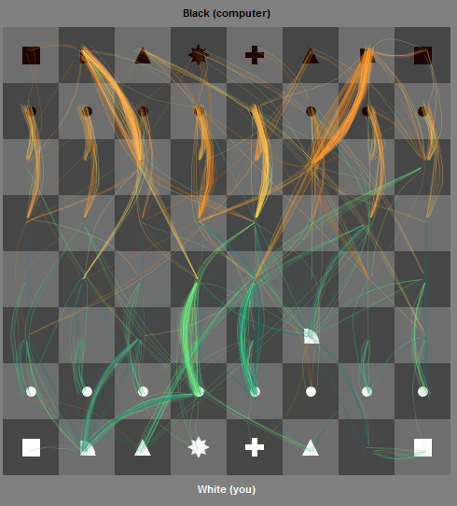
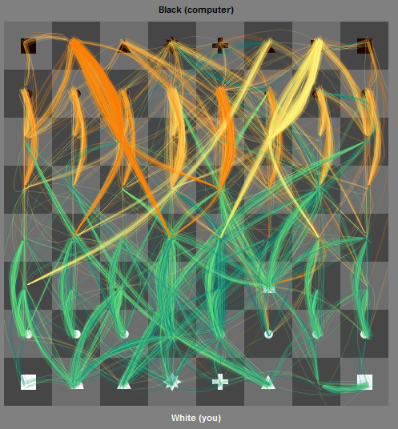
Beyond Graphs
State Machine Models
  Thinking Machine

Slide 36
Questions?
Richard Johnson
richardj@microsoft.com

Slide 37
Thank you! http://swiscience alias: pandora
Richard Johnson
richardj@microsoft.com

